Slide 1
Connecting to the Internet

Slide 2
Connecting to the Internet -
What is a Wireless Network
SAUSD Chromebooks and iPads connect to the Internet using wireless network connections.
A wireless network is used to connect laptops, cell phones and other devices to the Internet.
If you have access to a wireless network at home you will be able to connect SAUSD Chromebooks and iPads.
Notes:
Wireless network uses radio waves to connect to laptops, cell phones, and other devices that are enabled to receive wireless signals to the Internet.
Be careful and don’t do online banking or shopping. Anyone could access your personal account information.

Slide 3
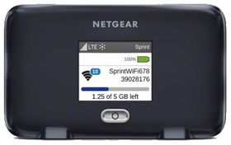
What is a Hotspot?
A hotspot allows you to connect wirelessly to Chromebooks and iPads. The hotspot has a network name and password that will need to be entered in the device in order for the hotspot to provide Internet access.
Get Started Hotspot PowerPoint
Video for Connecting Your Chromebook to WiFi
Notes:
Info is on the slide. Hotspots come with a user guide, your school site will also be able to help with hotspot setup.

Slide 4
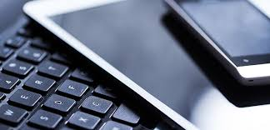
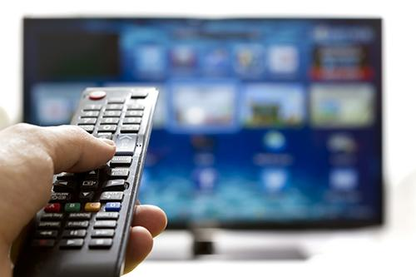
What do you use to connect to the Internet?
Notes:
Ask parents about their use of the internet. What do you use at home to connect to the Internet?

Slide 5
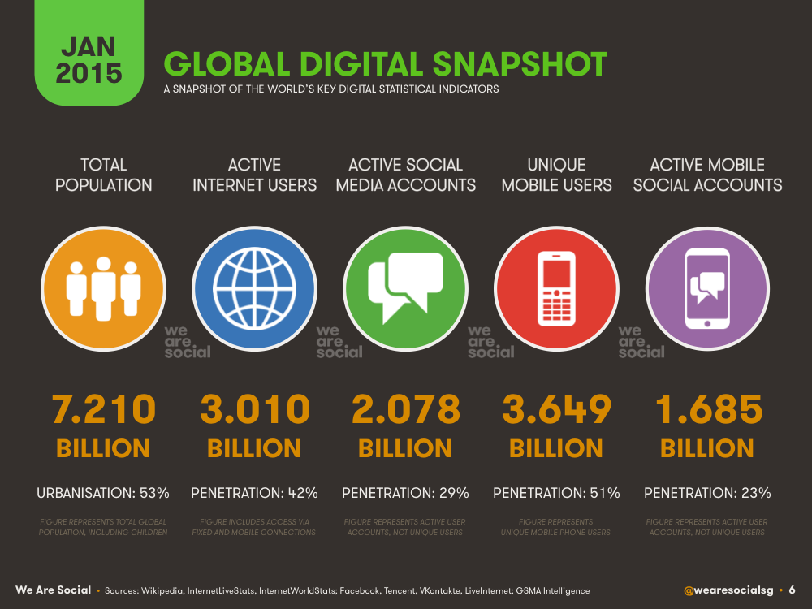
Notes:
we’re all on the internet!

Slide 6
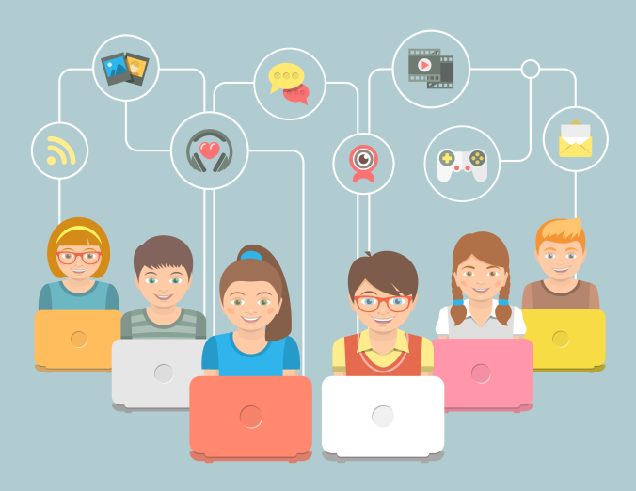
Notes:
...and so are your children!

Slide 7
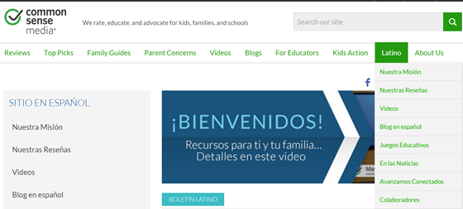
Parenting in the Online World
https://www.commonsensemedia.org/latino
¿Cómo usar la tecnología de forma segura y balanceada?
Notes:
Common Sense Media is a wonderful website with wonderful resources for parents in English and Spanish. The screen shot shows the landing page for the Latino section. Click on and show the video (3:03 minutes).

Slide 8
Notes:
End of class 1. Ask if there are any questions or comments.

